Slide 1


Design Portfolio
Spencer Larsen

Slide 2
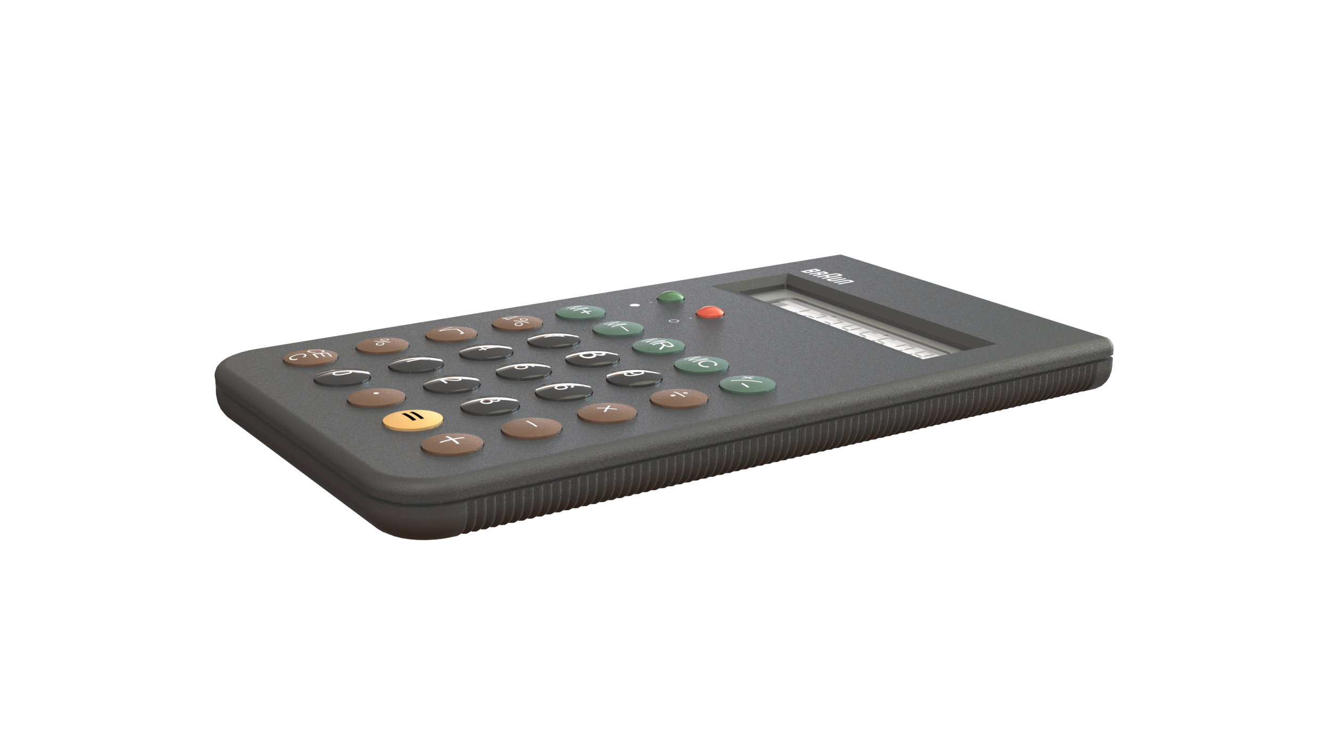
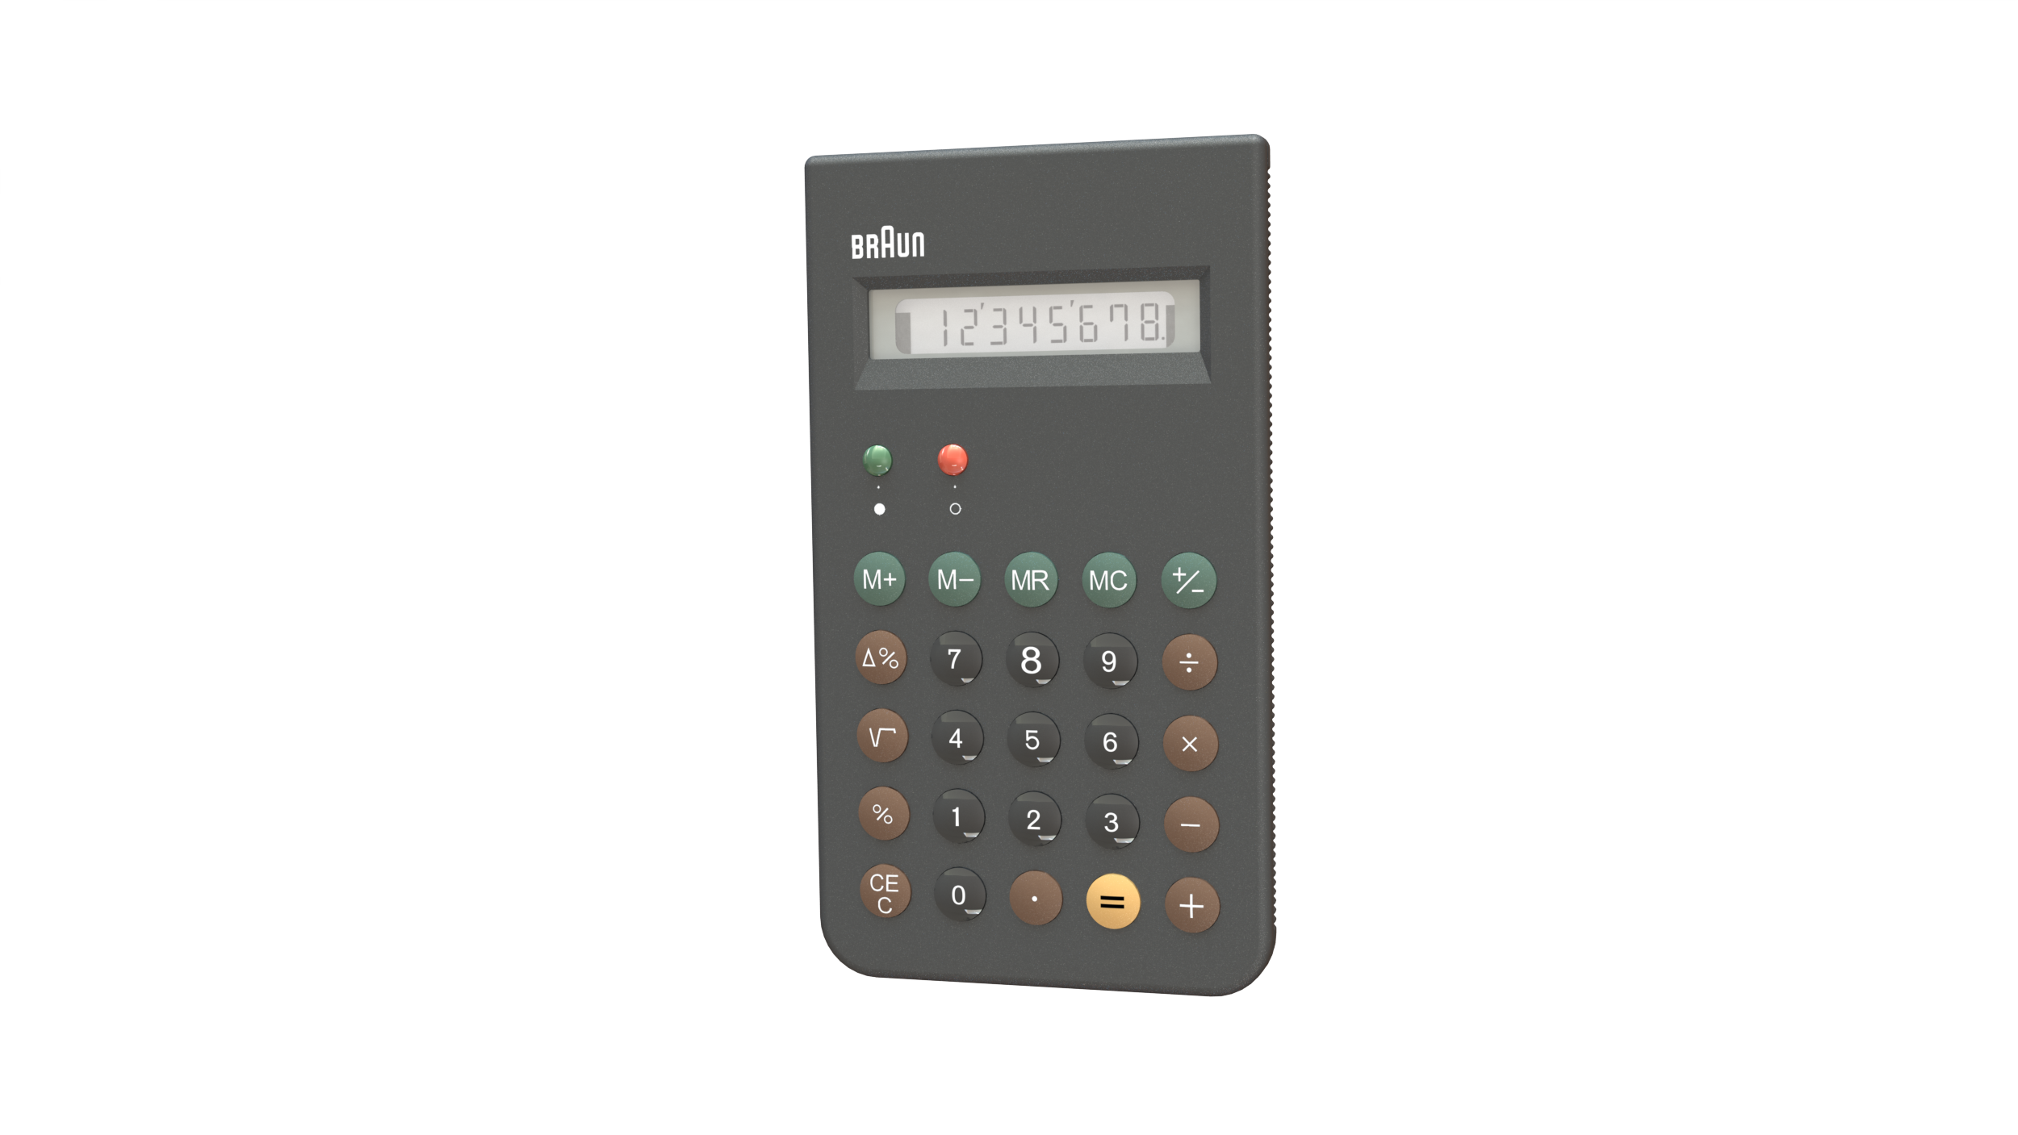
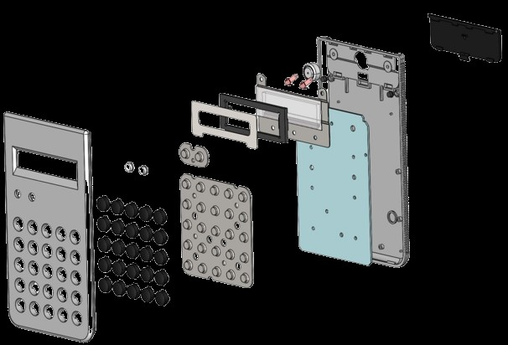
BRAUN ET66 Calculator
38 Pieces
Calculator modeled for injection molding. It is an exact representation of the real model.

Slide 3
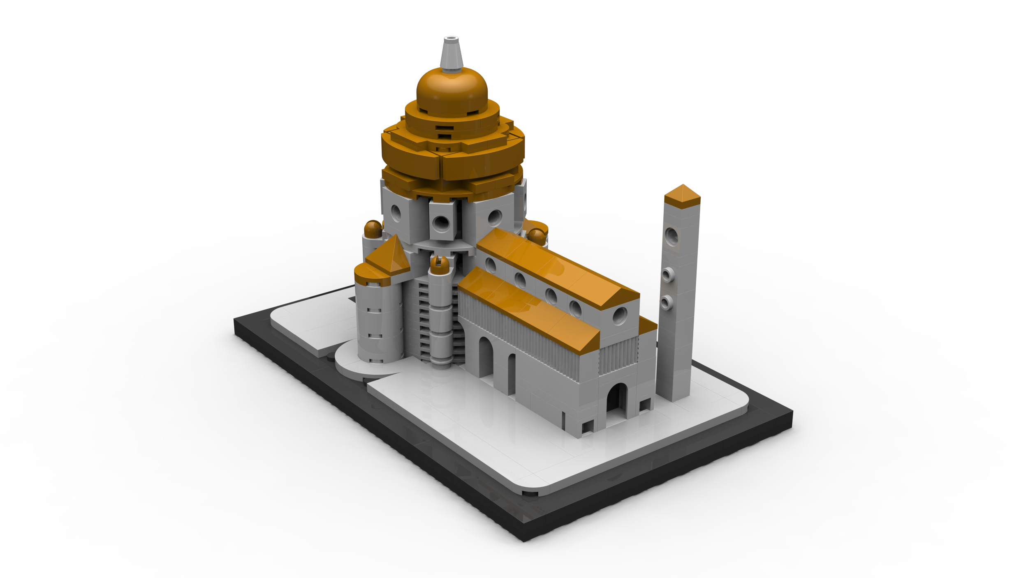
Cathedral de Santa Maria del Fiore
308 Pieces
Model of the Cathedral de Santa Maria del Fiore in Florence using only existing LEGO pieces all individually modeled and assembled.

Slide 4
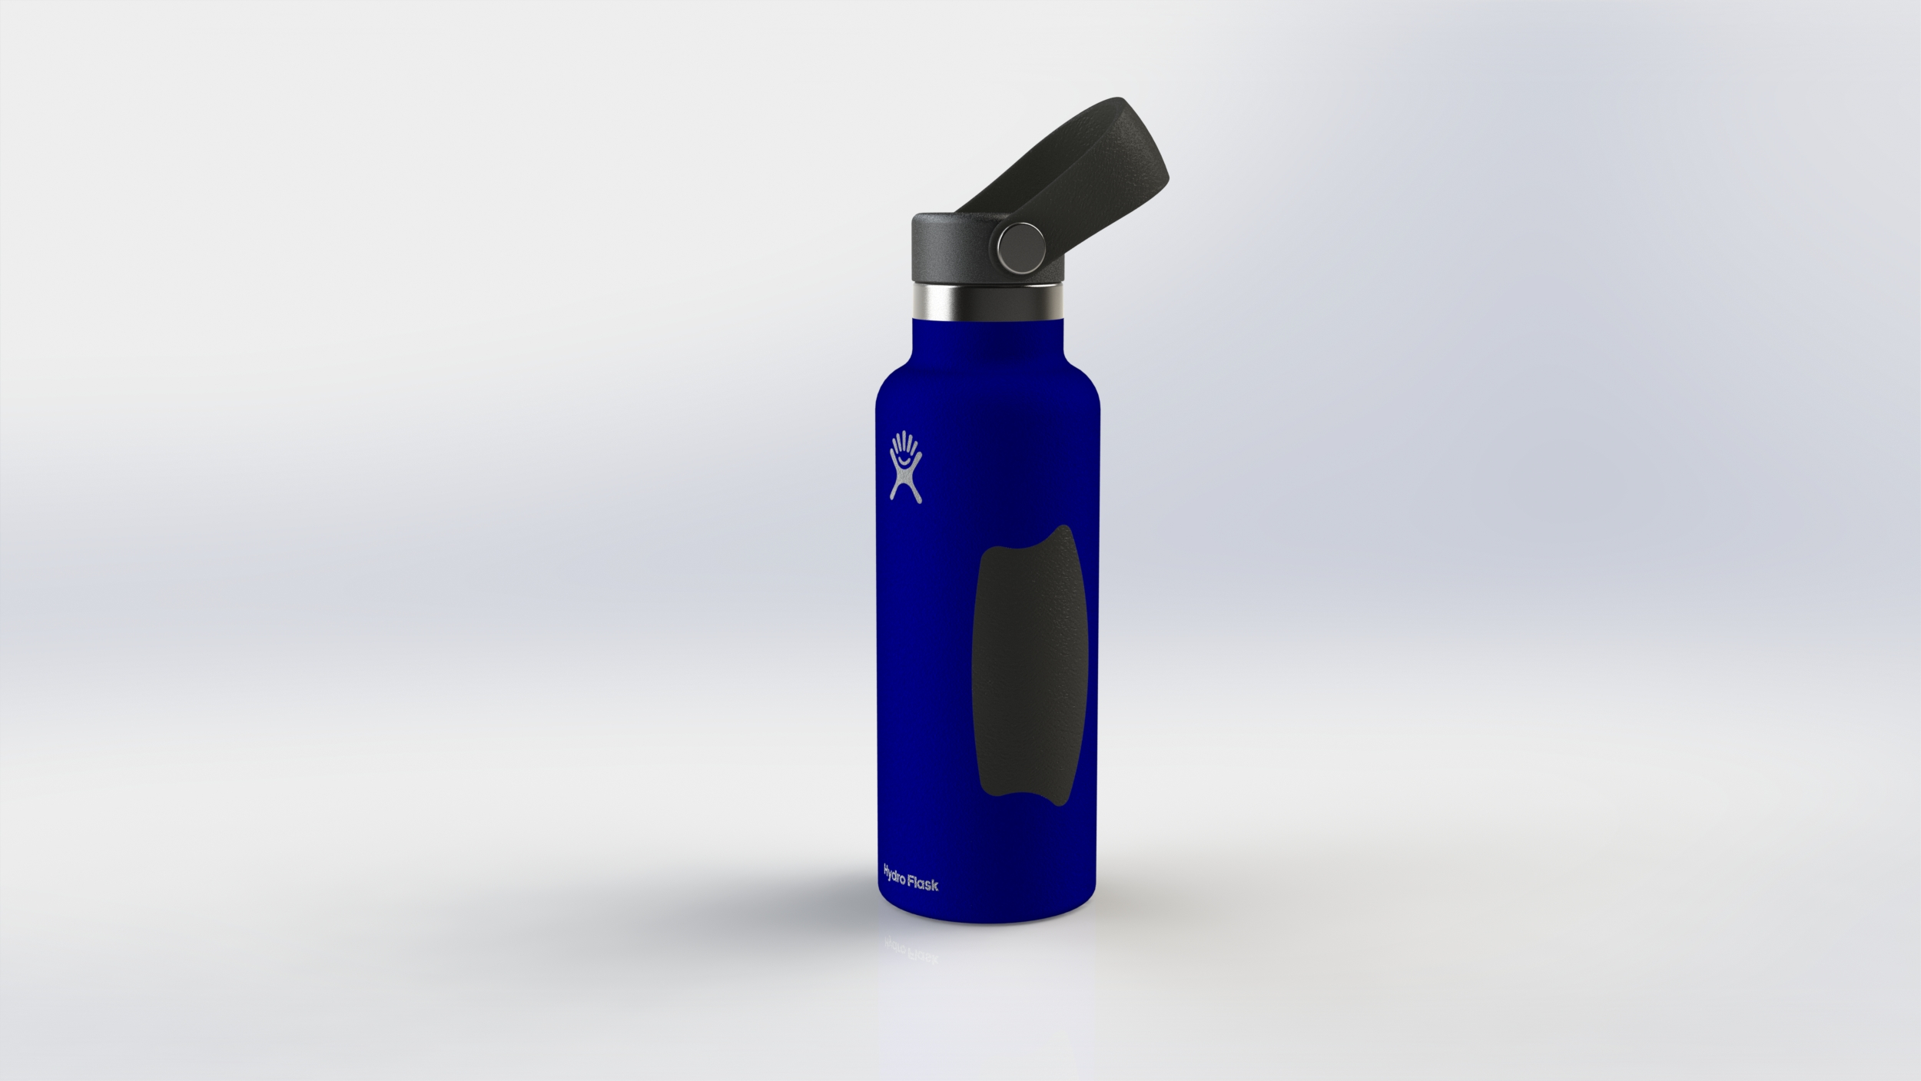
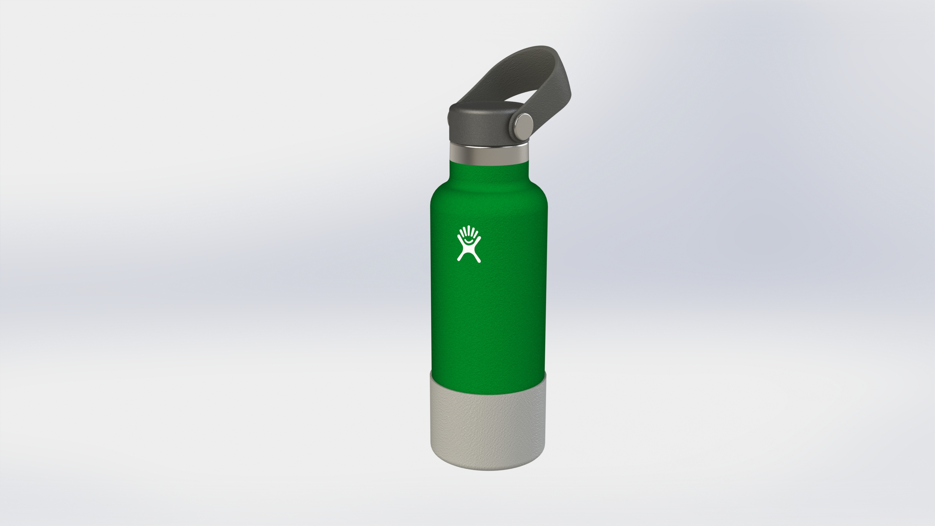
Hydro Flask Bottles
Modeled using surface modeling. Left bottle has a customized non-slip grip. Right has a master-modeled boot.

Slide 5
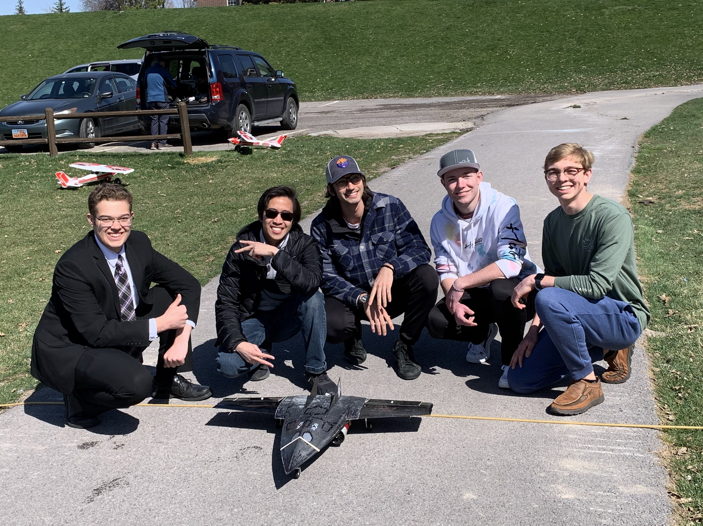
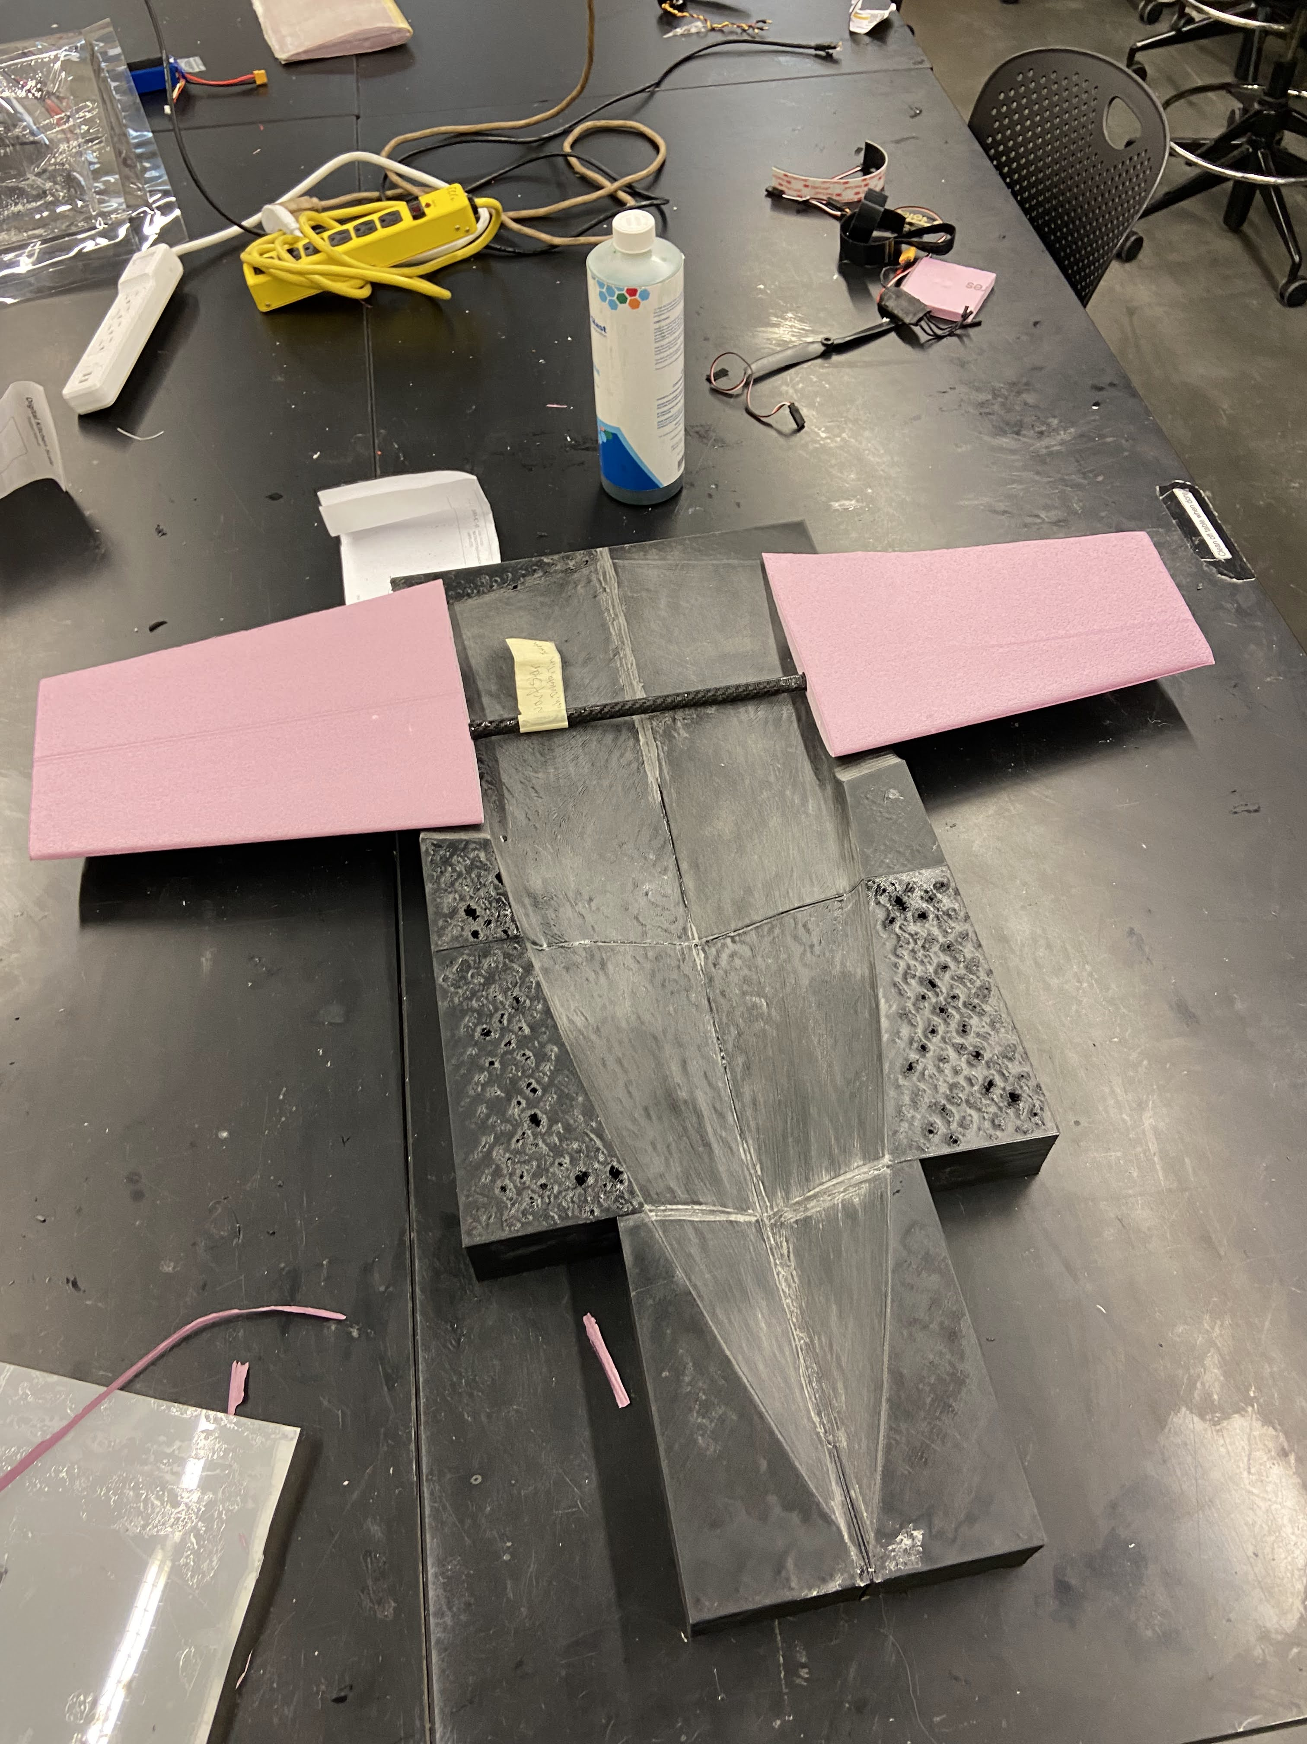
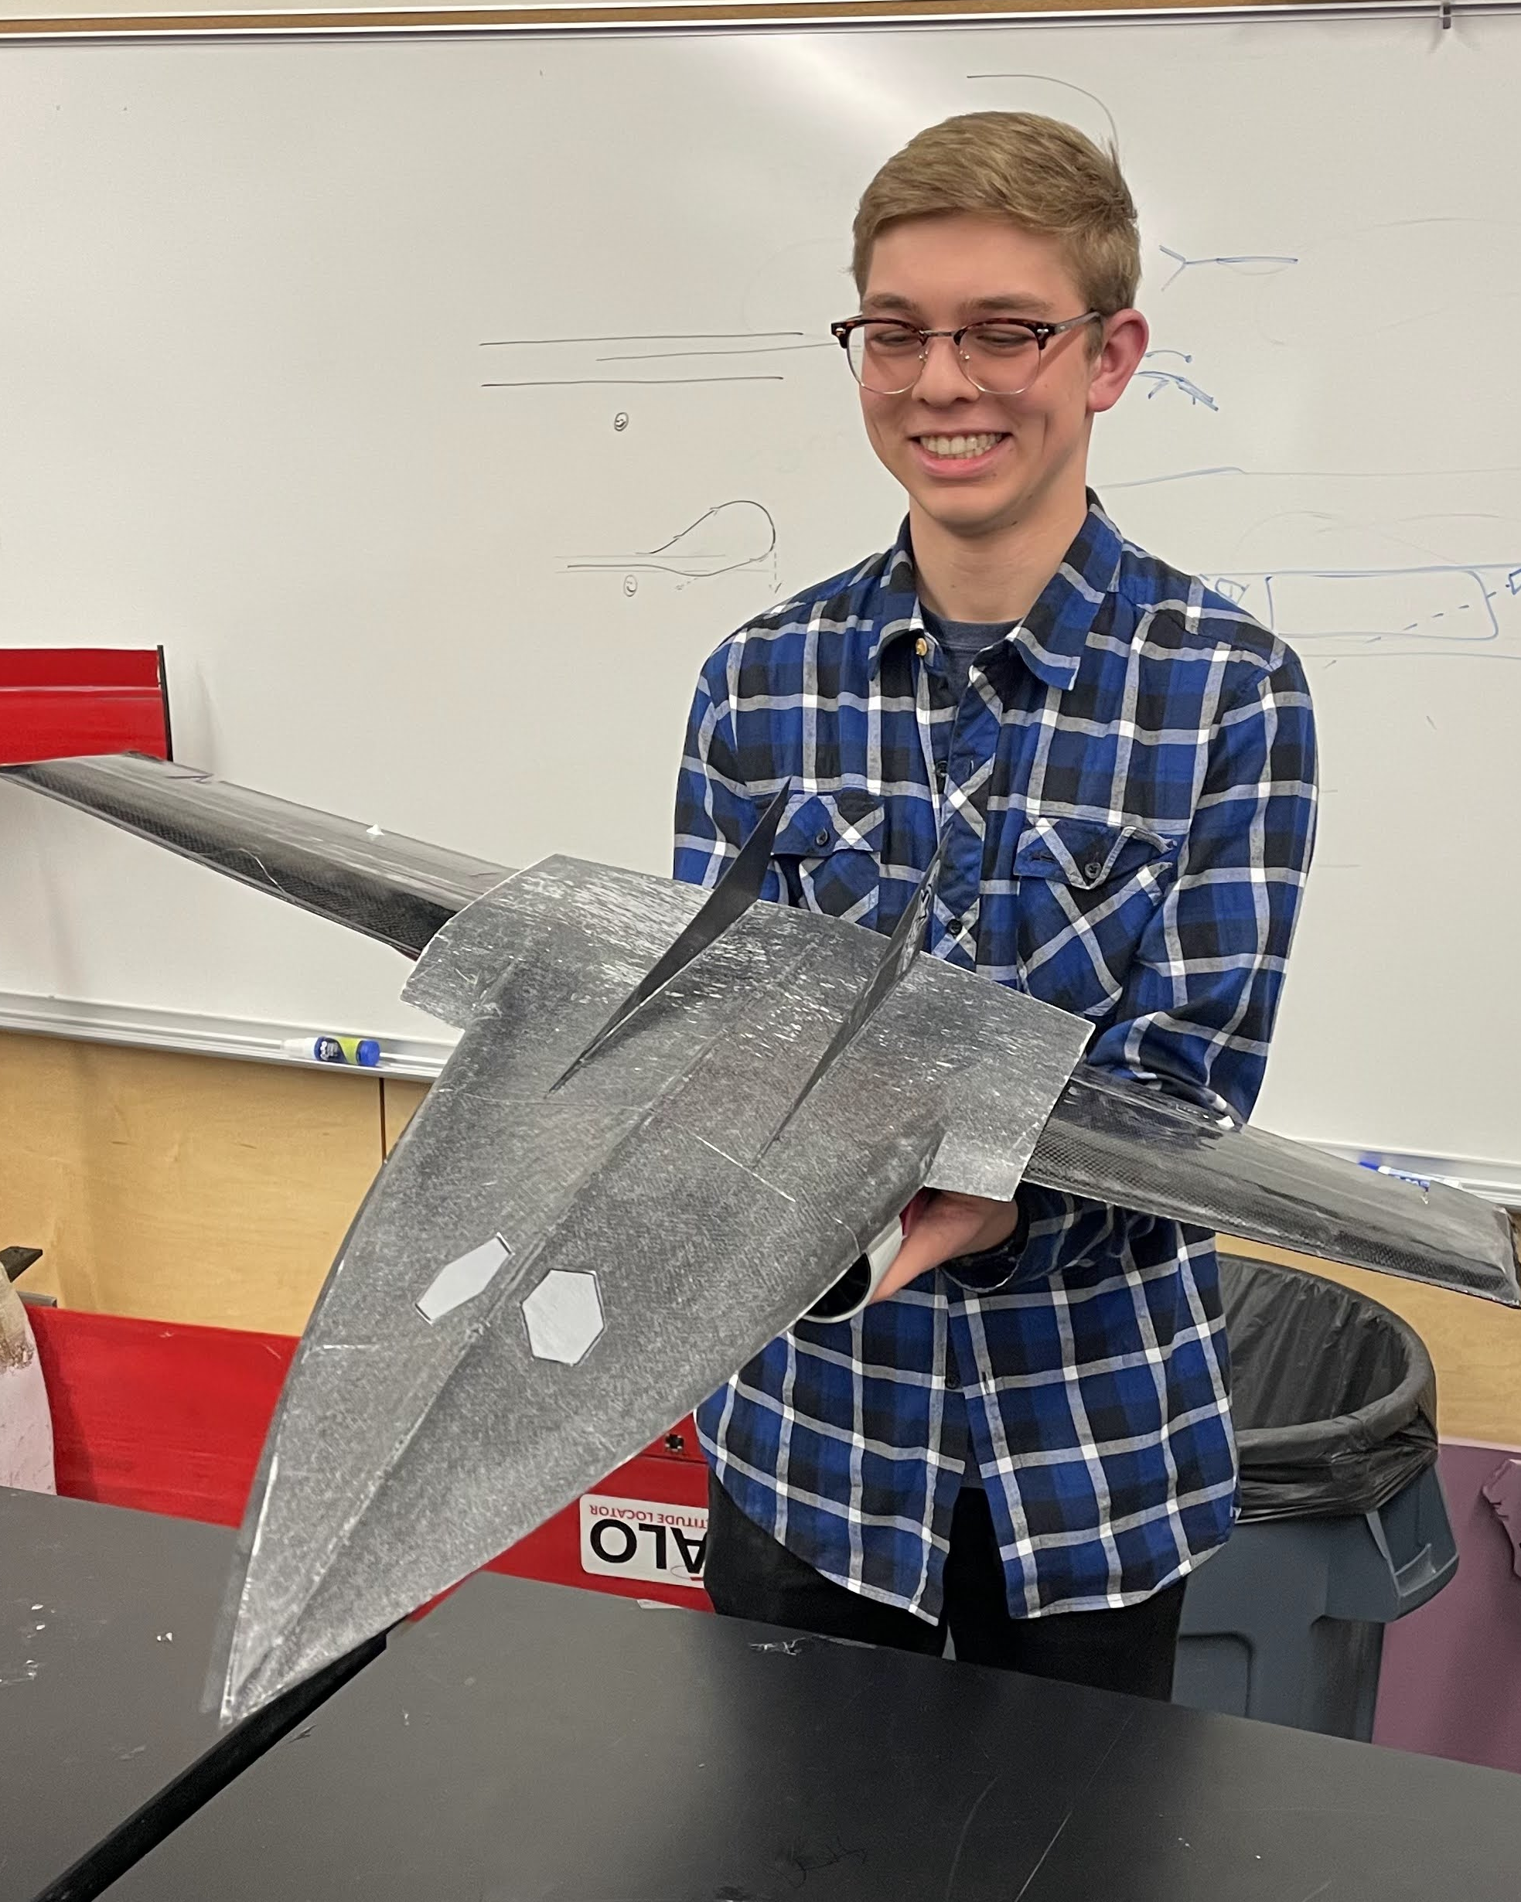
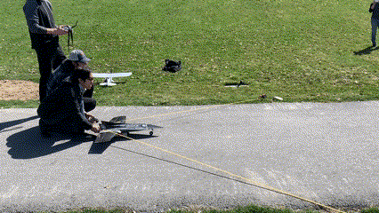
Dwarf Star
Competed within the BYU Aeronautics team with a carbon fiber wet layup jet with electronic ducted fans (EDF). Uses a three-cell battery

Slide 6
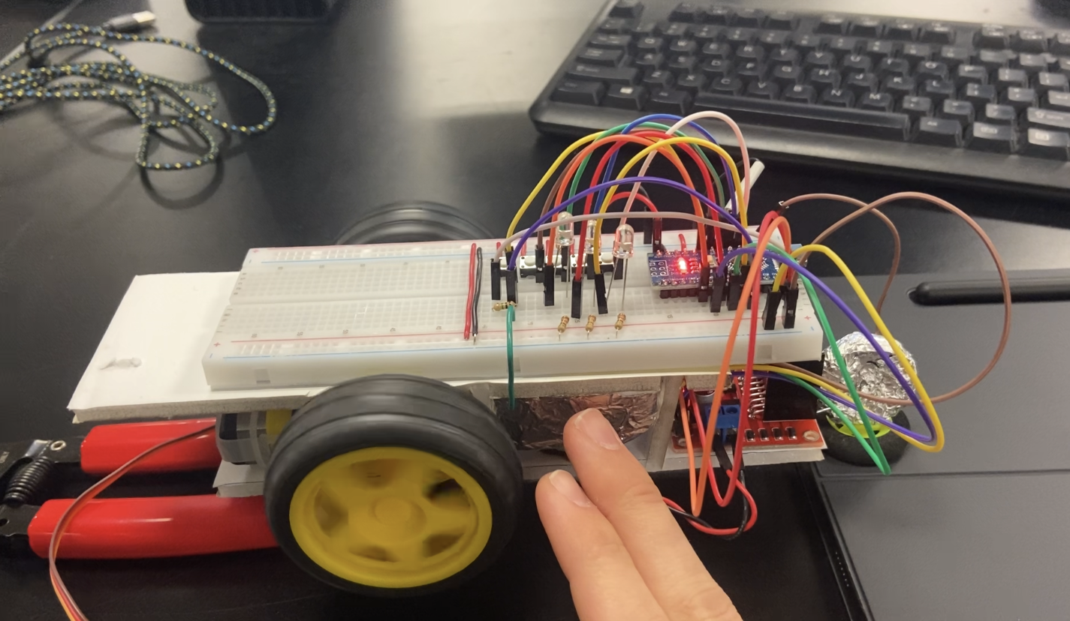
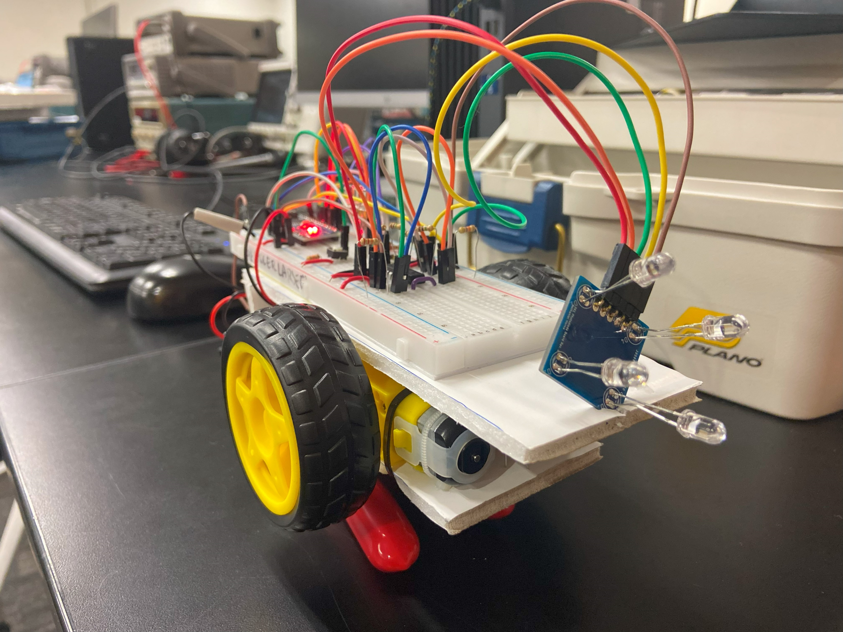
Light Following Robot
https://www.youtube.com/playlist?list=PLXE_czn0dVys5cwsjzQoLACRViC03Beni
A continual progress update of a light following robot that utilizes DC motors, photodiodes, a servo motor, a capacitive touch sensor and printed circuit boards alongside finite state machines to contribute to robot perception, planning and action.

Slide 7
